Slide 1
Efficient Markets Theory Fall 2019 Sheridan Titman
Notes:
Do we have other title suggestions? Investment Externalities and their effect on Financial Markets and Public Policy

Slide 2
Outline
The investment management business
Who are the players?
Characterizing information
Soft (subjective) versus hard (objective)
Defining market efficiency
Understanding the relation between liquidity and market efficiency
Quant analysis versus traditional fundamental analysis

Slide 3
Investment Management Players
Firms and individuals seeking capital
Retail Investors
Long term institutional investors (mutual funds, hedge funds, pension funds, sovereign wealth funds)
Traditional fundamental investors and buy side analysts
Active quants
Smart beta/passive quants
Indexers
Short-term traders
Technical and high frequency traders
Market makers

Slide 4
Information Collectors
Buy-side Analysts
Employed by investors to collect and analyze information
Sell-side Analysts
Employed by brokers
Collect fundamental information from other investors as well as from firms
If you have an exceptional ability to uncover pertinent information are you more valuable to the buy side or the sell side?
Why do investors provide information to sell side analysts?

Slide 5
To a large extent, investors can be defined by how they collect and use information

Slide 6
Fundamental Investors
Tend to mix quantitative analysis and judgement to project cash flows
Value companies by discounting cash flows
Evaluate comparative advantage and expansion options
Compare computed values to market prices
Buy the underpriced shares
Sell the overpriced shares

Slide 7
Technical Traders
Use information from past prices and volume patterns to infer investor demand
Try to make money by providing liquidity and anticipating order flows
“Reading the charts” to interpret market sentiment
The important point is that they try to learn from investor actions rather than from information about firms
Being displaced by high frequency traders (HFTs) using machine learning

Slide 8
Quant Investors
Hypothesize statistical relationships based on theory and judgement
Need a theory based on behavioral biases or institutional frictions
Back-test the idea
The theory implies a portfolio strategy that should have a positive alpha
If the back-test looks favorable, create a signal that is used in portfolio selection

Slide 9
Characterizing Information
Hard information – objective information that can be quantified
Accounting numbers, economic indicators, trading volume, insider holdings, education of managers, etc.
Text analysis and sentiment indicators
Machine readable
The HFT and quants rely exclusively on hard information
Soft information – subjective information
Opinions on strategies, capabilities, mgt. quality etc.
Requires judgement

Slide 10
Selectivity versus Timing Information
Is the overall stock market predictable?
Timing information is about the direction of the overall market or broad sectors
Most of the difference in the performance is due to allocation to sectors or styles
Can we predict which firms beat the market?
Selectivity information is about whether or not individual stocks will beat the market

Slide 11
Efficient Markets
In an efficient market,
prices fully and rationally reflect all information
and investors cannot systematically earn excess returns
Are these two statements equivalent?
Can market prices deviate from fundamentals and not offer opportunities to earn excess returns?

Slide 12
Efficient Markets 101
Austin Technologies benefits from its great location and has attracted the best talent to it organization. Given its superior talent, it is expected to grow much faster than the competition.
Baltimore Technologies is facing some challenges attracting talent, which is severely affecting its ability to develop new products.
Which stock would you prefer?
Are the expected rates of return necessarily equal?

Slide 13
Characterizing Market Efficiency
Weak and semi-strong efficiency
Prices fully reflect freely available hard information
Strong efficiency
Prices fully reflect soft information that may be difficult to gather and costly to interpret as well as hard information

Slide 14
Do we expect markets to be fully efficient?
No,
Collecting and interpreting information is time consuming and costly. If market prices fully reflect all information, there is no incentive to gather information. Someone needs to gather and trade on information to make markets efficient.

Slide 15
But How Inefficient?
Inefficient enough to attract active managers …
But not so inefficient that active managers make money too easily
Equilibrium: (in theory)
There is enough active managers so that they make a competitive wage that reflects their talents, training etc.

Slide 16
A useful thought experiment
To a large extent, stock trading is a zero-sum game
For you to win, your counterparty needs to lose
Are you smarter than your counterparty?
Most trades come from sophisticated institutions
Are they trading because they have different information than you?
Are they trading for non-information reasons?

Slide 17
The No Trade Theorem
There will be no trade unless
Investors have non-information reasons to trade
A sudden need for cash
An inflow of cash that needs to be invested
Overconfidence
Both sides of the trade think they are smarter than the other
Always ask –
“who is on the other side of my trades?”
“if the smart investors are overweight chemicals, who are the dumb investors who are underweight chemicals?”

Slide 18
But what if all investors simply choose to hold the market portfolio?

Slide 19
An Efficiently Inefficient Market
Individuals with no comparative advantage should invest in passive index funds (they shouldn’t trade)
Can they hire other (presumably) informed individuals to invest for them?
Only if they have a comparative advantage in evaluating informed investors
Most active mutual funds underperform after fees
It requires special skills to determine which funds will outperform
Why not just buy the funds that did well in the past?

Slide 20
Who should be active investors?
Who are the investors with a comparative advantage?
The Harvard endowment has an advisory board consisting of alums and faculty who have been successful in the finance industry
They should have a comparative advantage identifying investors with a comparative advantage
Individuals with both talent and capital
But if individuals tend to be overconfident, there may be “too many” active investors who think they have the special talent

Slide 21
Information and Liquidity
The liquidity of an investment can be viewed as the extent to which buying and selling the investment moves prices
Short-term traders are often viewed as liquidity providers
Limit orders provide liquidity (and are subsidized on some trading platforms)
Market orders consume liquidity
What are the incentives of investors to provide liquidity?
How do these incentives relate to information?

Slide 22
How do Market Makers Make (and lose) Money?
Market makers quote both bid (offers to buy) and ask (offers to sell) prices.
On average, the market maker makes money on trades against uninformed investors and loses money when trading against informed investors.
How is the spread influenced by the probability that an order is coming from an informed investor?
How does the mix between informed and uninformed traders influence market impact?

Slide 23
Behavioral Finance 101
Two important behavioral biases
Limited attention
We tend to underweight information that is not salient
Overconfidence
We tend to think that our private information is more precise than it really is
We tend to be dismissive about the precision of other people’s information

Slide 24
Overconfidence
To some extent overconfident investors are needed for well-functioning liquid markets
Traders need to believe that they are better informed than their counterparty
Investors will not invest in information in illiquid markets
At the same time, many quant strategies are designed to exploit overconfident investors
Value strategies
Equity issuance strategies
Momentum strategies

Slide 25
Salience and Limited Attention
Information that is not particularly salient may receive too little attention
Fundamental analysts try to rearrange accounting numbers to come up with better measures of earnings and book values …
The general idea is that complicated and subtle information may be underweighted

Slide 26
Overconfidence and the Overvaluation of Growth Stocks
Companies A, B and C are competing in a winner takes all market
Investors collect (soft) information that help them predict the winner
Because they collect different information or interpret it differently, they have different opinions about who will be the winner
If there are constraints on short-selling, stock prices tend to reflect the more optimistic investors (the pessimists simply don’t participate)

Slide 27
Overconfidence and the Underreaction to Corporate Announcements
Why do firms issue equity?
Good investment opportunities
Managers believe their shares are overpriced – the evidence tends to support this second explanation
How should stock prices react when firms issue equity?
Will prices over or under-react to issuance choices?
If investors are overconfident about how precisely they value the stock prior to the announcement, prices overreact
If they put too much weight on their prior beliefs it follows that they put too little weight on the new information

Slide 28
Overconfidence, Momentum and Reversals
Stock prices can change for three reasons
Reaction to public information
Price reaction due to trades based on private information
Price reaction due to trades based on liquidity needs and noise
If investors overestimate the precision of their private information, they will tend to overreact
If investors are dismissive about others, they will tend to provide too much liquidity, which implies underreaction

Slide 29
Overconfidence, Momentum and Reversals
Theories of momentum and reversals are based on
If overconfident investors overreact to their own private information – overreaction generates subsequent reversals
If overconfident investors are dismissive about the precision of other investor’s information – dismissive investors underreact to the order flow, generating subsequent momentum
Dismissive investors may react to old information (they learn something that is already incorporated in stock prices)

Slide 30
Overconfidence and Market Inefficiency: A General Theory
Stock prices reflect a mix of hard and soft information
Optimal mix determined by the precision of soft information
What if investors are overconfident about their interpretation of soft information?
Too much weight on soft information
Too little weight on hard information
Implies underreaction to hard information
Explains the motivation for using pure quant strategies

Slide 31
How do we test for market efficiency?
Testing for weak and semi-strong efficiency
Evaluate trading strategies that utilize hard selectivity information
Quant investors as well as academics do this
The tests are identical to other tests of the CAPM/APT, i.e., we estimate the alphas of the relevant strategies
Testing for strong efficiency
Evaluate the performance of professional investors, e.g., mutual funds and hedge funds
Do these investors tend to generate positive alphas?
Do they tend to exhibits higher betas in up markets than in down markets?

Slide 32
Some of my past research
"The Valuation Effects of Stock Splits and Stock Dividends," (with Mark Grinblatt and Ronald Masulis), Journal of Financial Economics, December 1984.
"Mutual Fund Performance: An Analysis of Quarterly Portfolio Holdings," (with Mark Grinblatt), Journal of Business, July 1989.
"The Persistence of Mutual Fund Returns," (with Mark Grinblatt), Journal of Finance. December 1992.
"Returns to Buying Winners and Selling Losers: Implications for Stock Market Efficiency," (with Narasimhan Jegadeesh), Journal of Finance, March 1993.
“Profitability of Momentum Strategies: An Evaluation of Alternative Explanations” (with Narasimhan Jegadeesh), Journal of Finance, 2001.

Slide 33
Stock Split Study
Stock splits are purely cosmetic events – Should prices react to these announcements?
Do we expect prices to underreact or overreact to these announcements?
Theory – splits attract attention to firms – which firms are most likely to want the attention?
Stock prices react favorably to stock split announcements
about 2-3% return
The evidence suggests that the market underreacts
Test for underreaction by measuring the returns (and alphas) of strategies based on buying stocks that announced a split in the last N months.
How do you interpret this evidence with respect to the behavioral theories?

Slide 34
Momentum Studies
It’s natural to ask whether stock prices over or under-react to information and looking at the relation between past returns and future returns is a natural way to ask this question.
Portfolio strategy:
Rank stocks based on past returns over the past J months.
Form portfolios based on these past returns
Measure returns and alphas of the portfolio strategy over the next K months

Slide 35
Mechanical Explanations for Momentum Returns
Underreaction to information (private or public)
Delayed over-reaction to information
Implies a subsequent reversal
We do observe subsequent reversals in some time periods but not always
High beta stocks underreact to the market
Momentum should be stronger in more volatile markets
The evidence does not support this, but momentum does seem to be stronger following bull markets

Slide 36
Recent Research
Stock price manipulation: Corporate actions and the exploitation of retail investors in China, (with Chishen Wei and Bin Zhao)
Out of sample evidence on stock splits in the US and a comparison to the situation in China
Geographic Lead-Lag Effects, (with Chris Parsons and Riccardo Sabbatucci)
The relation between lead-lag effects and portfolio momentum

Slide 37
Stock Splits Revisited
Do we expect to observe the post-announcement stock split effect after 2000?
Most anomalies weakened or disappeared post-2000
Maybe the split effect is tied to momentum and weakened along with momentum
How are the return patterns different in China?
Primarily an under-educated retail market
Essentially no short-selling
Are stock splits used to facilitate manipulation in China?

Slide 38
Daily abnormal returns around stock split announcement: China vs US market
Announcement on day=0

Slide 39
Monthly abnormal returns after split announcement: Regular vs. Suspicious splits in China
Announcement in month=0

Slide 40
Post-2000 Evidence
There still seems to be some underreaction in the US
For the Chinese, we divided the sample into subsamples
Suspicious splits – suspicious accounting and suspicious timing
Not suspicious splits
We also looked separately at SOEs and private firms
For the SOEs and not suspicious private firms, the evidence is similar to the US
Positive announcement returns and weak evidence of a positive post-announcement drift
For suspicious private firms
Positive returns for first couple of months, and then strong reversal

Slide 41
Lead-Lags
There is a relatively short-term strategy that is sometimes referred to as pairs trading, lead-lag trading, or portfolio momentum trading. My impression is that some of the funds that were doing what they referred to as statistical arbitrage was doing something similar.
The general idea: GM and Ford are exposed to the same factor or industry risk, but may react at slightly different times. If GM outperforms Ford today, we expect Ford to outperform GM tomorrow.
If we assume that the stocks do not over-react to the information, then industry lead-lag effects generate industry momentum.
In other words, within industry lead-lags create opportunities for within industry contrarian strategies and across industry momentum strategies

Slide 42
Group Classification
The trick here is to group stocks into clusters that are likely to be exposed to the same factor exposures
How do we do this?
Is there a purely statistical classification methodology?
Can machine learning help?
My conjecture – you want firms that are exposed to similar factors but which are followed by different analysts.

Slide 43
Geographic Lead-lag Effects
Establish that the stock returns of firms headquartered in the same cities tend to be correlated after controlling for industry co-movement
Look at long-term correlations versus short-term correlations. If long-term correlations are larger, there is likely to be a lead-lag relation
Form portfolios and estimate alphas

Slide 44
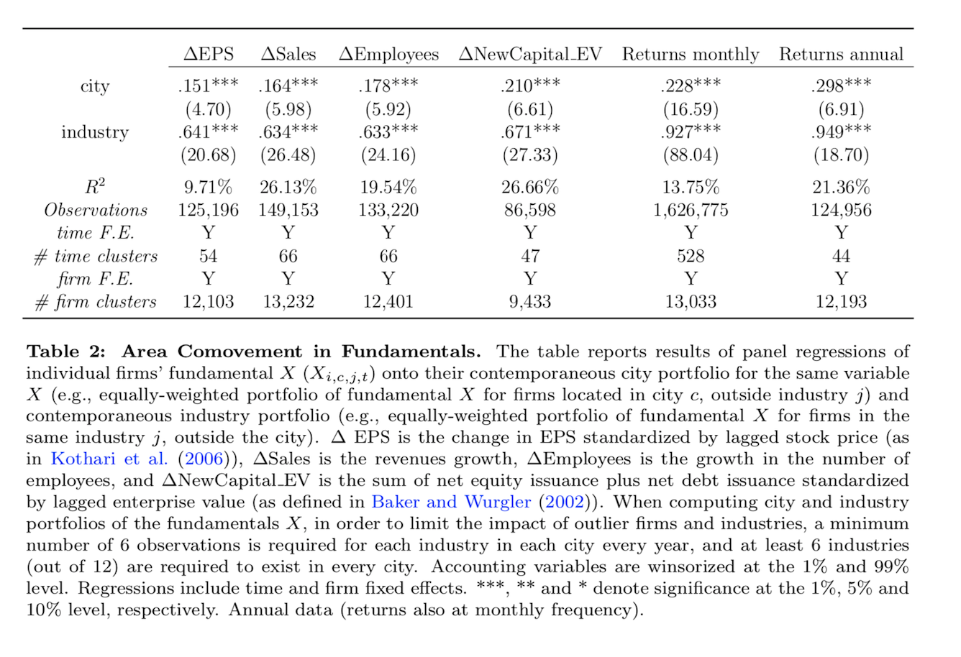
Comovement in fundamentals and returns

Slide 45
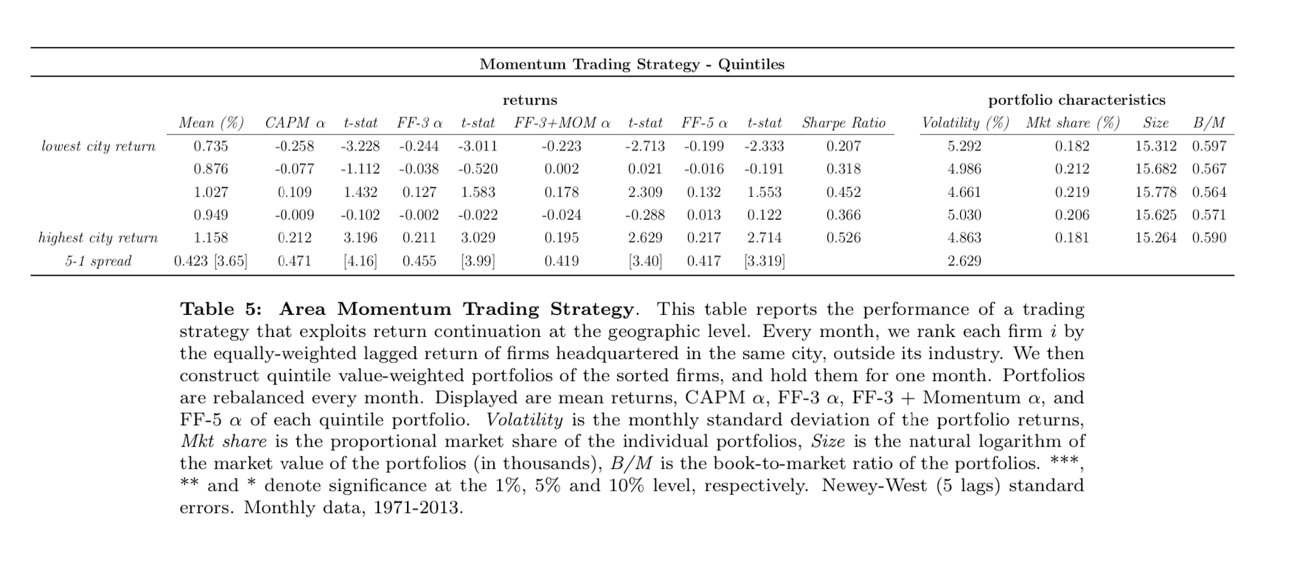
Long-short trading strategy

Slide 46
Concluding Thoughts
The cost of active management must be compensated
In a completely rational world, markets cannot be completely efficient
Irrationality cuts both ways – it can contribute to both efficiency and inefficiency
Investors buy and sell for a variety of reasons – someone must take the other side of these trades
Always consider the motivation of your counterparty
Deviating from a “market portfolio” increases risk – this risk must be compensated
Trading individual stocks at significant volume moves prices
What affects liquidity?
Why are baskets of securities more liquid than individual stocks?

Slide 47
Concluding Thoughts
5. Evaluating soft information requires judgement
Individuals tend to be overconfident about the precision of their judgement
This implies that they put too little weight on hard information
6. Think about efficiency with respect to specific types of information

